Slide 1
COMBINATIONAL CIRCUITS
COMPUTER SYSTEM ARCHITECTURE
BY:
ROSHNI PATOA

Slide 2
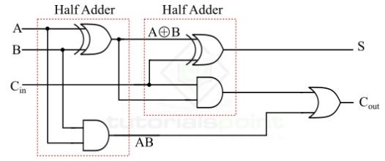
IMPLEMENTATION OF FULL ADDER USING HALF ADDERS
The logic diagram of the full adder using two half adders is shown below:

Slide 3
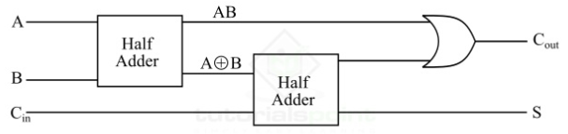
IMPLEMENTATION OF FULL ADDER USING HALF ADDERS
The block diagram of the full adder using two half adders is shown below:

Slide 4
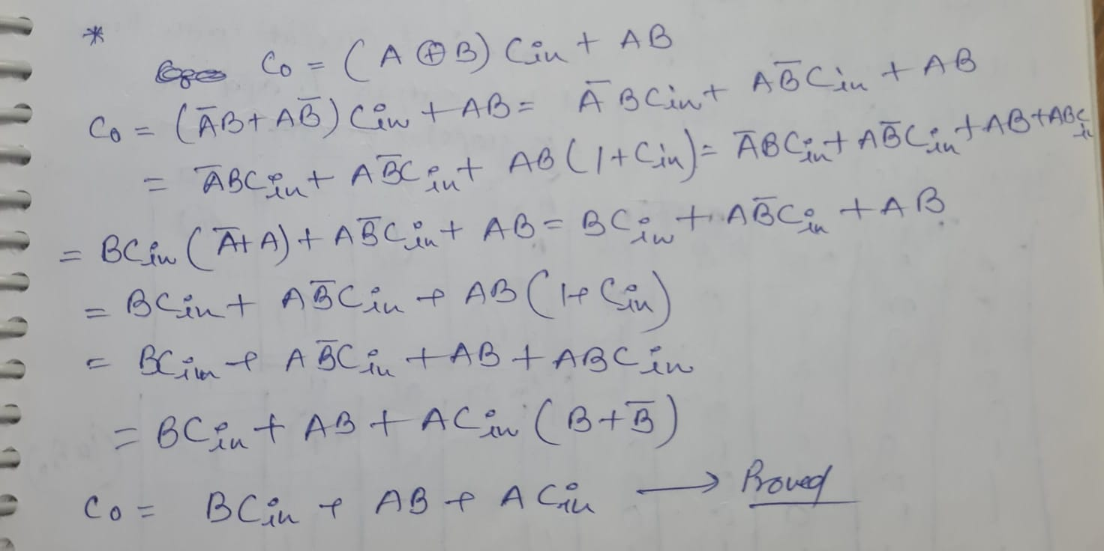
IMPLEMENTATION OF FULL ADDER USING HALF ADDERS

Slide 5
IMPLEMENTATION OF FULL ADDER USING HALF ADDERS
From the logic diagram of the full adder using half adders, it is clear that we require two XOR gates, two AND gates and one OR gate for the implementation of a full adder circuit using half-adders.
However, the implementation of full adder using half adder has a major disadvantage that is the increased propagation delay. That means, the input bits must propagate through several gates in succession that increases the total propagation delay of the full adder circuit.

